Slide 1

Introduction to PsychToolbox in MATLAB
Psych 599, Summer 2013
Jonas Kaplan, Ph.D.
University of Southern California
Week 1

Slide 2
Course details
Instructor: Jonas Kaplan, Ph.D.
Office: DNI 251
OH: Weds 2-4
Course website: https://blackboard.usc.edu

Slide 3
What is Psychtoolbox?
Psychophysics Toolbox is a set of Matlab functions for behavioral research
It runs on Mac, Windows, and Linux
Allows precise control of your screen, audio, collection of responses
Controls low-level system events using a high-level language (Matlab)
Freely available
http://psychtoolbox.org

Slide 4
What is Matlab?
“MATLAB® is a high-level language and interactive environment for numerical computation, visualization, and programming. Using MATLAB, you can analyze data, develop algorithms, and create models and applications. The language, tools, and built-in math functions enable you to explore multiple approaches and reach a solution faster than with spreadsheets or traditional programming languages, such as C/C++ or Java™.
You can use MATLAB for a range of applications, including signal processing and communications, image and video processing, control systems, test and measurement, computational finance, and computational biology. More than a million engineers and scientists in industry and academia use MATLAB, the language of technical computing.

Slide 5
Becoming a programmer: why?
Increase your freedom
Increase your scientific value
Enjoyment
Exercise your logical mind

Slide 6
PROGRAMMING == PROBLEM SOLVING

Slide 7
The process of programming
Programming is not a linear process
Lots of trial and error
Problem solving, detective work, deductive reasoning
Debugging may take longer than initial writing. Enjoy it!

Slide 8
Learning how to programming
Learn how to learn
Practice
Proficiency is not in being able to do everything you need to do, but knowing how to figure out what you need to do when you don’t know

Slide 9




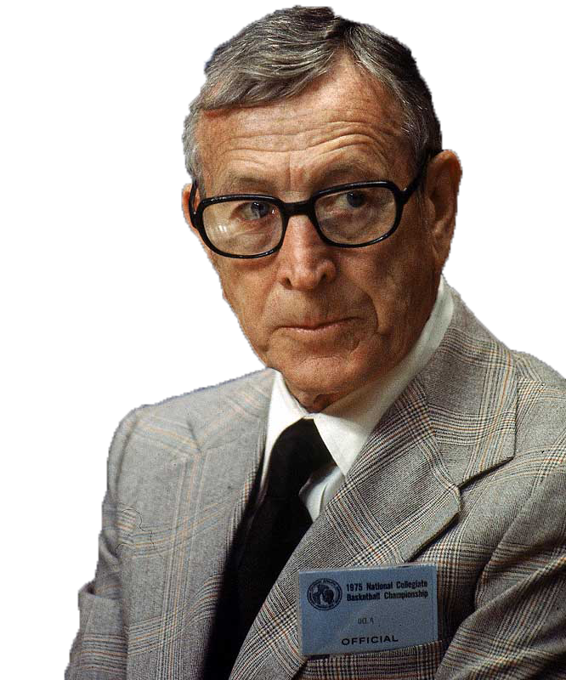
If you don't have time to do it right, when will you have time to do it over?
Make it work!

Slide 10
Coding philosophy
The “Tim Gunn principle”
There are many different ways to make things work.
The prettiest way is not always the most desirable.
Top priority is that your script does what you want it to do.
The “Tom Wooden principle”
Good coding practices are important
Assume you will remember nothing next time you look at your code
Assume someone else will be using your code
Assume your script will at some point move to another computer

Slide 11
Structure of the course
Each four hour period will be divided into lecture and exercise
Each week you will complete a programming assignment
Final exam is to build a complete experiment

Slide 12
Calendar
Week 1:
Introduction to
MATLAB
Week 2:
MATLAB
programming
Week 3:
Controlling
the screen
Week 4:
Sound and
multimedia
Week 5:
Responses and
experimental design
Week 6:
Reading your data;
Putting it all
together

Slide 13
Pre-class poll

Slide 14
Pre-class poll

Slide 15
Pre-class poll

Slide 16
Pre-class poll

Slide 18
Getting the software and looking around

Slide 19
Getting the software
Get MATLAB: http://software.usc.edu
Get Psychtoolbox: http://psychtoolbox.org
May also need:
Gstreamer SDK to play video: http://www.gstreamer.com (make sure to check all the boxes when you install)

Slide 20
Tour
Knowing your way around the UI
Getting back to default layout
Customizing layout

Slide 21
The Command Window and Command History
Typing in commands
moving through history
re-executing commands
tab completion

Slide 22
The file browser
Moving around through the folder hierarchy
Command line tools for navigation cd change directory ls list directory contents . current directory .. parent directory

Slide 23
The workspace and variable editor
Settings variables: x = 3
Clearing variables: clear x clear all

Slide 24
Matlab settings
Customizations
PATH

Slide 25
Basics of the MATLAB language

Slide 26
MATLAB language
Interpreted language
Static variable typing: every variable must have a pre-determined type

Slide 27
Getting help
help function
doc function
pop-up help
>> help sin
sin Sine of argument in radians.
sin(X) is the sine of the elements of X.
See also asin, sind.
Reference page in Help browser
doc sin

Slide 28
Scripts
Anything you type into the workspace can also be run from a script
“.m” files are just saved lists of matlab commands
functions

Slide 29
The Editor
Comments
Syntax highlighting
Code folding

Slide 30
Variables
What is a variable?
Variable names and conventions

Slide 31
Variable types
Numbers
double: floating point number like 3.24
integer: no decimal places 345

Slide 32
Vectors and matrices
Vectors are like lists a = [1,2,3,4,5]
Matrices are like lists of lists a = [ 1,3,5,7; 2,4,6,8 ]
Matrices can have many dimensions

Slide 33
Creating vectors
>> a = [1 2 3 4 5]
a =
1 2 3 4 5
>> a = [1,2,3,4,5]
a =
1 2 3 4 5
>> a = [1:5]
a =
1 2 3 4 5

Slide 34
Creating matrices
>> a = [1 2 3; 4 5 6]
a =
1 2 3
4 5 6
>> a = [1 2 3; 4 5 6; 7 8 9]
a =
1 2 3
4 5 6
7 8 9

Slide 35
Creating matrices
>> ones(3)
ans =
1 1 1
1 1 1
1 1 1
>> ones(2,3)
ans =
1 1 1
1 1 1
>> zeros(3,4)
ans =
0 0 0 0
0 0 0 0
0 0 0 0
(rows,columns)

Slide 36
Creating matrices
>> rand(3)
ans =
0.8147 0.9134 0.2785
0.9058 0.6324 0.5469
0.1270 0.0975 0.9575
>> nan(4)
ans =
NaN NaN NaN NaN
NaN NaN NaN NaN
NaN NaN NaN NaN
NaN NaN NaN NaN
NaN = “Not a Number”

Slide 37
Describing matrices
size() will tell you the dimensions of a matrix
length() will tell you the length of a vector

Slide 38
Accessing elements
>> a = [0:4]
a =
0 1 2 3 4
>> a(2)
ans =
1
>> b = [1,2,3;4,5,6;7,8,9]
b =
1 2 3
4 5 6
7 8 9
>> b(2,3)
ans =
6
Also try:
x = [1:0.1:10]

Slide 39
Accessing elements
>> b(1:3,1)
ans =
1
4
7
>> b(1,:)
ans =
1 2 3

Slide 40
Vector math
Adding a constant to each element in a vector
Adding two vectors
>> a = [1 2 3]
a =
1 2 3
>> a + 1
ans =
2 3 4
>> b = [5 1 5]
b =
5 1 5
>> a + b
ans =
6 3 8

Slide 41
Vector multiplication
The * sign refers to matrix multiplication:
>> a = [1 2 3]
a =
1 2 3
>> b = [2 2 4]
b =
2 2 4
>> a * b
Error using *
Inner matrix dimensions must agree.
>> b = b'
b =
2
2
4
>> a * b
ans =
18
transposing a matrix:
use ‘ to transpose, i.e. flip rows and columns

Slide 42
Vector multiplication
The .* sign refers to element-wise multiplication:
>> a = [1 2 3]
a =
1 2 3
>> b = [2 2 4]
b =
2 2 4
>> a .* b
ans =
2 4 12
>> a * 4
ans =
4 8 12
>> a .* 4
ans =
4 8 12

Slide 43
Operators
Element-wise operators: .* multiplication ./ division .^ exponentiation
Many other functions work element-wise, e.g.:
>> a = [1 4 9]
a =
1 4 9
>> sqrt(a)
ans =
1 2 3

Slide 44
Working with strings
Strings in Matlab are vectors of characters
Always use single quotes to define strings
>> name = 'Jonas'
name =
Jonas
>> name(1)
ans =
J
>> name(1:3)
ans =
Jon

Slide 45
Working with strings
>> x = 'abc'
x =
abc
>> y = 'def'
y =
def
>> x + y
ans =
197 199 201
>> double('a')
ans =
97
>> double('d')
ans =
100
>> char(97)
ans =
a

Slide 46
Working with strings
>> strcat(x,y)
ans =
abcdef
>> newstring = strcat(x,y)
newstring =
abcdef
>> newstring = strcat(x,y);
>>
results stored in new variable
semicolon suppresses output of results

Slide 47
Formatting strings
What do we typically do with strings?
Printing out messages to the workspace
Printing out data or messages to files
Using them as stimuli in an experiment
Using them as filenames, codes, or identifiers

Slide 48
Formatting strings
Several ways to print a string out to the workspace:
type the name of the variable w/o a trailing semicolon
disp() is almost the same as above, except it does not print out the variable name
fprintf() is for formatting text and printing out to a file or other device, such as the workspace
sprintf() is for formatting text in order to create new string variables

Slide 49
Working with strings
>> name = 'Fred';
>> name
name =
Fred
>> disp(name)
Fred
>> fprintf(name)
Fred>> sprintf(name)
ans =
Fred
notice the lack of newline character

Slide 50
Formatting strings
fprintf() is a very powerful command for formatting strings, combining them, and printing them out
>> help fprintf
fprintf Write formatted data to text file.
fprintf(FID, FORMAT, A, ...) applies the FORMAT to all elements of
array A and any additional array arguments in column order, and writes
the data to a text file. FID is an integer file identifier. Obtain
FID from FOPEN, or set it to 1 (for standard output, the screen) or 2
(standard error). fprintf uses the encoding scheme specified in the
call to FOPEN.
fprintf(FORMAT, A, ...) formats data and displays the results on the
screen.

Slide 51
Formatting strings
>> employee = 'Fred';
>> age = 32;
>> score = 88.432;
>> fprintf('Employee: %s is %d years old and scored %f',employee,age,score);
Employee: Fred is 32 years old and scored 88.432000>>
These symbols that start with % are substitution points (‘conversion characters’). Matlab will insert the subsequent variables into the text, in order. The number of variables listed must match the number of conversion characters.
%s string
%d integer/digit
%i integer/digit
%f floating point number
%c single character

Slide 52
Formatting strings
>> >> fprintf('%s\t%d\n',employee,age)
Fred 32
There are many special characters to control formatting that begin with the backslash:
\t tab
\n newline
\v vertical tab

Slide 53
Working with numbers in strings
>> fprintf('Score: %f\n',score);
Score: 88.432000
>> fprintf('Score: %.2f\n',score);
Score: 88.43
>> fprintf('Score: %.0f\n',score);
Score: 88
>> fprintf('Score: %.5f\n',score);
Score: 88.43200
Specifies the number of decimal places in a floating point number
>> fprintf('Age: %d\n',age)
Age: 32
>> fprintf('Age: %.4d\n',age)
Age: 0032
Or the number of total digits in an integer

Slide 54
Special characters
>> fprintf ('Score was %.2f%%\n',score)
Score was 88.43%
>> fprintf('Name is ''%s''\n',name)
Name is 'Fred'
If you want to print the actual character instead of invoking its special meaning:
‘’ to print a single-quote
%% to print a percent sign

Slide 55
Creating string variables
>> help sprintf
sprintf Write formatted data to string.
STR = sprintf(FORMAT, A, ...) applies the FORMAT to all elements of
array A and any additional array arguments in column order, and returns
the results to string STR.
[STR, ERRMSG] = sprintf(FORMAT, A, ...) returns an error message when
the operation is unsuccessful. Otherwise, ERRMSG is empty.
sprintf is the same as FPRINTF except that it returns the data in a
MATLAB string rather than writing to a file.

Slide 56
Creating string variables
>> subject = 'SXF32';
>> logfileName = sprintf('data_%s.txt',subject);
>> logfileName
logfileName =
data_SXF32.txt
Make your variable names as informative as possible. Someone reading your code should know what a variable contains by looking at its name. That person might be Future You or a colleague.

Slide 57
Collections of strings
Lists of strings
>> names = ['Jonas','Fred','John']
names =
JonasFredJohn
Take note!
Curly braces -> Cell array
Straight braces -> regular array
Introducing cell arrays
>> names = {'Jonas','Fred','John'}
names =
'Jonas' 'Fred' 'John'

Slide 59
Cell arrays
Cell arrays can mix and match data types.
Each cell is its own self-contained variable
Cell arrays can be arranged in multiple dimensions just like matrices

Slide 60


Using cell arrays
>> mycell = {'hello',4,'goodbye',543.43}
mycell =
'hello' [4] 'goodbye' [543.4300]
>> mycell = {[1:5],[6:10]}
mycell =
[1x5 double] [1x5 double]
>> mycell(1)
ans =
[1x5 double]
>> mycell{1}
ans =
1 2 3 4 5
access the cells themselves
access the contents of the cells

Slide 61
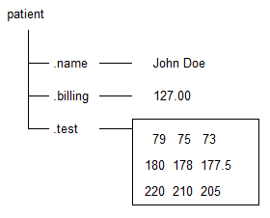
Structures
Structures can be used to organize and group information
>> patient.name = 'John Doe';
>> patient.billing = 127.00;
>> patient.test = [79, 75, 73; 180, 178, 177.5; 220, 210, 205];
>> patient
patient =
name: 'John Doe'
billing: 127
test: [3x3 double]

Slide 62
Arrays of structures
>> patient(2).name = ’Jane Doe';
>> patient(2).billing = 156.00;
>> patient(2).test = [71 73, 55; 101, 22, 22; 242, 211, 205];
>> patient
patient =
1x2 struct array with fields:
name
billing
test
>> patient(1)
ans =
name: 'John Doe'
billing: 127
test: [3x3 double]

Slide 63
Saving variables
save() to save the workspace to disk
load() to load a .mat file that contains variables from disk
clear() to remove a variable from memory
who, whos to list variables in memory

Slide 64
Saving variables
>> who
Your variables are:
age employee mycell patient score
>> whos
Name Size Bytes Class Attributes
age 1x1 8 double
employee 1x4 8 char
mycell 1x2 304 cell
patient 1x2 1056 struct
score 1x1 8 double

Slide 65
Saving variables
>> save('matlabclass1')
>> clear
>> who
>>
>> load('matlabclass1')
>> who
Your variables are:
age employee mycell patient score
>> save('onevar','patient')
>> clear
>> who
>> load('onevar')
>> who
Your variables are:
patient

Slide 66
Writing scripts

Slide 67
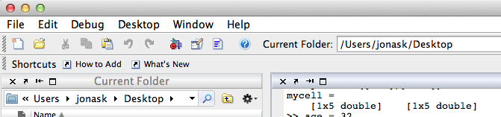
Creating a script
create new blank document

Slide 68
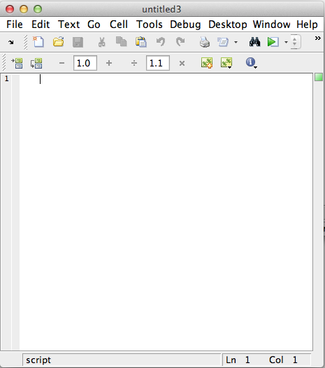
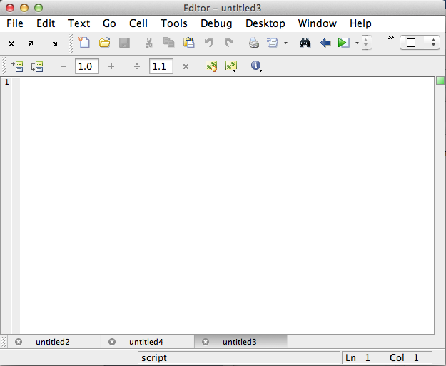
Editor options
Docking and undocking tabs

Slide 69
Your first script
% My first script
x = 5;
y = 6;
z = x + y
Save script as “myFirst.m”
>> myFirst
z =
11

Slide 70
Functions

Slide 71
What is a function?
A function is a self-contained piece of code that accomplishes a specific function
It may take in certain variables (parameters) and return results

Slide 72

Function declarations
All functions must be declared, that is, introduced in the proper way.
code folding
result of the function
name of the function
parameters passed to the function
OUT
IN

Slide 73
Function declarations
Functions may return no variables:
function printAName(name)
%Not very exciting. Just prints a name.
fprintf(‘The name is: %s\n’,name);
Or several:
function [avg,biggest,smallest] = getSomeStats(x)
%Return some statistics on vector x
avg = mean(x);
biggest= max(x);
smallest = min(x);

Slide 74
Variable scope
Variables only exist within a certain “scope”
Variables defined in a function only exist within that function

Slide 75
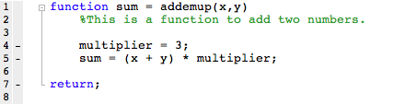
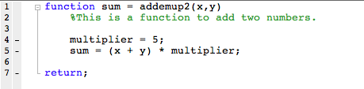
Variable scope
>> addemup(1,1)
ans =
6
>> addemup2(1,1)
ans =
10

Slide 76
Coding style
Your code needs to be readable by humans as well as by machines
Never trust yourself to remember anything. You will always forget. Just because something appears obvious now does not mean it will in the future, or to someone else.
Use comments to explain what you are doing in English.

Slide 77
Coding style
In a collaborative laboratory setting your code is not just for you:
you need to write to allow other people to update and change your code for their purposes
you need to write your code to be as flexible as possible. this means we will expect the code to be transported to other machines, and other environments

Slide 78
Comments
Comments start with % and appear in green in the editor
Can appear on their own line, or on a line with code provided they are after the semicolon
May use comments to temporarily disable lines of code

Slide 79


Coding style
ist= 10;
sst= 4;
r= [1,2];
ist = ist/fr;
sst = sst/fr;
%set up standard presentation parameters
instructionScreenTime = 10; %how long the instructions will stay on, in seconds
stimulusScreenTime = 4; %how long the stimulus will stay on, in seconds
acceptableResponses = [1,2]; %which responses buttons the subject may press
%convert times from seconds into frames
instructionScreenTime = instructionScreenTime/frameRate;
stimulusScreenTime = stimulusScreenTime/frameRate;

Slide 80
Coding style
Make your comments informative
%add two to the instruction screen time
instructionScreenTime = instructionScreenTime + 2; %here we are adding two
%add time to the instruction screen time to account for
%the additional time needed by this subject population
instructionScreenTime = instructionScreenTime + 2;

Slide 81
Coding style
Matlab does not enforce spacing and indentation, but you should for code readability
Keep blocks of code clearly demarcated

Slide 82
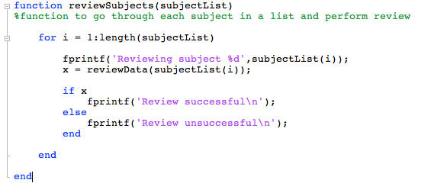
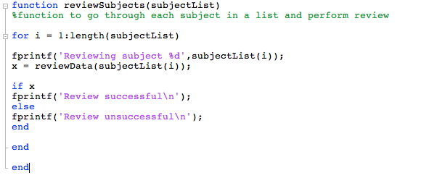
Coding style

Slide 84
Assignment instructions
Assignment will be emailed to me before the next class
Should be .m file; name it with your initials, an underscore, and the week, e.g.: jtk_week1.m
Please work alone on assignments
Should run as-is
Should be readable

Slide 85
Week #1 assignment
Write a function named “yourInitials_week1()”
The function should take two inputs: 1) a string containing the subject’s code 2) a vector of 5 scores
The function should return two values: 1) the mean of the 5 scores, after removing the lowest one 2) the standard error of the mean of the 5 scores after removing the lowest one
The function should also do the following when run: 1) print the following line to the screen: “Working on subject XXXX…” where XXXX is the subject code 2) plot a bar graph with the 5 scores

